Slide 1
OPERATING SYSTEM SEMINAR GOALS OF SECURITY & PROTECTION
Team Members :
ENG19CS0307 Shwetha M
ENG19CS0316 Sonia Reddy G S
ENG19CS0325 Suraj Bhadra
ENG19CS0334 Tejaal M
ENG19CS0352 Vandan kumar K
ENG19CS0361 Vikram S
ENG19CS0370 Yaswanth Velpuri

Slide 2
INDEX
Introduction
Goals of protection
Principles of protection
Domain of protection
Domain Structure
Goals of Security
Levels of security measures
Conclusion

Slide 3
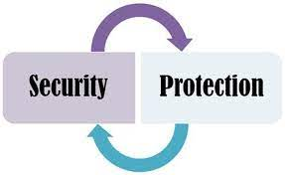
INTRODUCTION
In an Operating System, there are various users, who share either the programs or the data lying on the system. That is why a lot of risk is involved. There is a need of protection and security measures in an operating system.
Operating System uses two sets of techniques to counter threats to information namely Security and Protection.
Security refers to providing protection to computer system resources such as CPU, memory, disk, software programs and most importantly data stored in the computer system.

Slide 4
If a computer program is run by an unauthorized user, then he/she may cause severe damage to computer or data stored in it.
Protection refers to a mechanism which controls the access of programs, processes, or users to the resources defined by a computer system.
So, an operating system has to apply safeguards against the internal as well as external interference to a system. That is why protection and security go together.
We mainly need protection for the following reasons:
To prevent the access of unauthorized users.
To ensure that each active programs or processes in the system uses resources only as the stated policy.
To improve reliability by detecting latent errors.
So, in the upcoming sections we will learn the goals, domains and principles of security and protection.

Slide 5
GOALS OF PROTECTION
As computer systems have become more sophisticated and pervasive their applications, the need to protect their integrity has also grown.
Protection was originally conceived as an adjunct to multiprogramming operating systems, so that untrustworthy users might safely share a common logical name space, such as a directory of files, or a common physical name space, such as memory.
Modern protection concepts have evolved to increase the reliability of any complex system that makes use of shared resources and is connected to insecure communications platforms such as the Internet.
We need to provide protection for several reasons. The most obvious is the need to prevent the mischievous, intentional violation of an access restriction by a user. Of more general importance, however, is the need to ensure that each process in a system uses system resources only in ways consistent with stated policies. This requirement is an absolute one for a reliable system.

Slide 6
Protection can improve reliability by detecting latent errors at the interfaces between component subsystems. Early detection of interface errors can often prevent contamination of a healthy subsystem by a malfunctioning subsystem.
Also, an unprotected resource cannot defend against use (or misuse) by an unauthorized or incompetent user.
A protection-oriented system provides means to distinguish between authorized and unauthorized usage.
The role of protection in a computer system is to provide a mechanism for the enforcement of the policies governing resource use.
These policies can be established in a variety of ways. Some are fixed in the design of the system, while others are formulated by the management of a system. Still others are defined by individual users to protect resources they “own.”
A protection system, then, must have the flexibility to enforce a variety of policies. Policies for resource use may vary by application, and they may change over time. For these reasons, protection is no longer the concern solely of the designer of an operating system.

Slide 7
The application programmer needs to use protection mechanisms as well, to guard resources created and supported by an application subsystem against misuse.
The protection mechanisms the operating system should provide, but application designers can use them as well in designing their own protection software. Mechanisms are distinct from policies.
Mechanisms determine how something will be done; policies decide what will be done. The separation of policy and mechanism is important for flexibility. Policies are likely to change from place to place or time to time.
In the worst case, every change in policy would require a change in the underlying mechanism. Using general mechanisms enables us to avoid such a situation.

Slide 8
PRINCIPLES OF PROTECTION
The principle of least privilege dictates that programs, users, and systems be given just enough privileges to perform their tasks.
Observing the principle of least privilege would give the system a chance to mitigate the attack.
If malicious code cannot obtain root privileges, there is a chance that adequately defined permissions may block all, or at least some, of the damaging operations.
In this sense, permissions can act like an immune system at the operating-system level.
An operating system following the principle of least privilege implements its features, programs, system calls, and data structures so that failure or compromise of a component does the minimum damage and allows them damage to be done less.

Slide 9
Managing users with the principle of least privilege entails creating a separate account for each user, with just the privileges that the user needs.
For example, if a program needs special privileges to perform a task, it is better to make it a SGID program with group ownership of "network" or "backup" or some other pseudo group, rather than SUID with root ownership. This limits the amount of damage that can occur if something goes wrong.
Computers implemented in a computing facility under the principle of least privilege can be limited to running specific services, accessing specific remote hosts via specific services, and doing so during specific times.
Another important principle, often seen as a derivative of the principle of least privilege, is compartmentalization.
Compartmentalization is the process of protecting each individual system component through the use of specific permissions and access restrictions.
Then, if a component is subverted, another line of defense will come to play and keep the attacker from compromising the system any further.

Slide 10
The careful use of access restrictions can help make a system more secure and can also be beneficial in producing an audit trail, which tracks divergences from allowed accesses.
An audit trail is a hard record in the system logs.
If monitored closely, it can reveal early warnings of an attack or provide clues as to which attack vectors were used, as well as accurately assess the damage caused.
Most importantly, no single principle is a panacea for security vulnerabilities.
Defense in depth must be used as multiple layers of protection should be applied one on top of the other.
At the same time, of course, attackers use multiple means to bypass defense in depth, resulting in an ever-escalating arms race.

Slide 11
DOMAIN OF PROTECTION
A computer system is a collection of processes and objects.
Each object has a unique name that differentiates it from all other objects in the system, and each can be accessed only through well-defined and meaningful operations.
Objects are essentially abstract data types.
The operations that are possible may depend on the object.
Requirements
A process should be allowed to access only those resources for which it has authorization.
At any time, a process should be able to access only those resources that it currently requires to complete its task known as need-to-know principle.
It is useful in limiting the amount of damage a faulty process can cause in the system.
To minimize the risks of possible security violations.
Example
A process p invokes a compiler to compile a particular file. The compiler should not be able to access files arbitrarily but should have access only to a well-defined subset of files related to the file to be compiled.
Conversely, the compiler may have private files used for accounting or optimization purposes that process p should not be able to access.

Slide 12
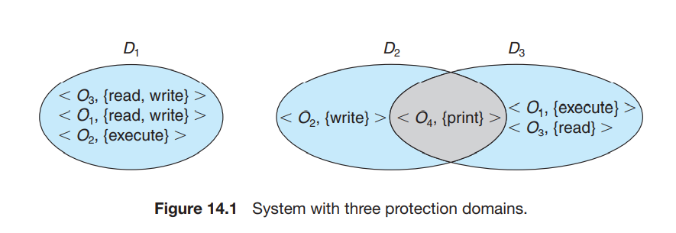
DOMAIN STRUCTURE
A process operates within a protection domain, which specifies the resources that the process may access.
The ability to execute an operation on an object is an access right.
A domain is a collection of access rights, each of which is an ordered pair,
<object-name, rights-set>

Slide 13
DOMAIN STRUCTURE
The association between a process and a domain may be either static, if the set of resources available to the process is fixed throughout the process’s lifetime, or dynamic.
In static , the need-to-know principle is violated. We must allow the contents of a domain to be modified so that the domain always reflects the minimum necessary access rights.
If the association is dynamic, a mechanism is available to allow domain switching, enabling the process to switch from one domain to another.
Example :dual-mode (monitor–user mode) model of operating-system execution.
A domain can be realized in a variety of ways:
Each user may be a domain.
Each process may be a domain.
Each procedure may be a domain.

Slide 14
GOALS OF SECURITY
Classification of Security Threats :
Breach of confidentiality: This type of violation involves unauthorized reading of data (or theft of information). Capturing secret data from a system or a data stream, such as credit-card information, can result directly in money.
Breach of integrity:. This violation involves unauthorized modification of data. Example modification of the source code of an important commercial or open-source application.
Breach of availability: This violation involves unauthorized destruction of data.
Theft of service : This violation involves unauthorized use of resources. For example, an intruder (or intrusion program) may install a daemon on a system that acts as a file server.

Slide 15
Denial of service. This violation involves preventing legitimate use of the system.
The most common is masquerading, in which one participant in a communication pretends to be someone else (another host or another person).
By masquerading, attackers breach authentication, the correctness of identification; they can then gain access that they would not normally be allowed.
Yet another kind of attack is the man-in-the-middle attack, in which an attacker sits in the data flow of a communication, masquerading as the sender to the receiver, and vice versa.
In a network communication, a man-in-the-middle attack may be preceded by a session hijacking, in which an active communication session is intercepted.

Slide 16
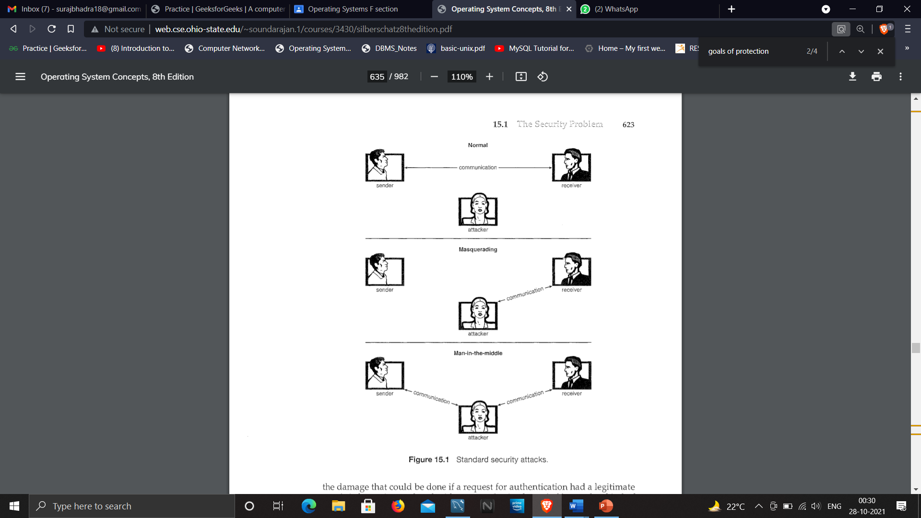

Slide 17
LEVELS OF SECURITY MEASURES:
PHYSICAL: The site or sites containing the computer systems must be physically secured against entry by intruders. for example by limiting access to the building they reside in, or locking them to the desk on which they sit.
HUMAN: Authorization must be done carefully to assure that only appropriate users have access to the system. They may also be tricked into allowing access via social engineering. Eg: Phishing, Dumpster diving, etc.
OPERATING SYSTEM: Operating systems must thus be kept up to date (via continuous patching and removing default settings) configured and modified to decrease the attack surface and avoid penetration.

Slide 18
4. NETWORK: computer data in modern systems frequently travel over private leased lines, shared lines like the Internet, wireless connections, and dial-up lines. Intercepting these data can be just as harmful as breaking into a computer, and interruption of communications can constitute a remote denial-of-service attack, diminishing users’ use of and trust in the system.
Application : Third-party applications may also pose risks, especially if they possess significant privileges. Some applications are inherently malicious, but even benign applications may contain security bugs.
Another factor that cannot be overlooked is the human one. Authorization must be performed carefully to ensure that only allowed, trusted users have access to the system.
Legitimate-looking e-mail or web page misleads a user into entering confidential information. Sometimes, all it takes is a click of a link on a browser page or in an email to inadvertently download a malicious payload, compromising system security on the user’s computer.

Slide 19
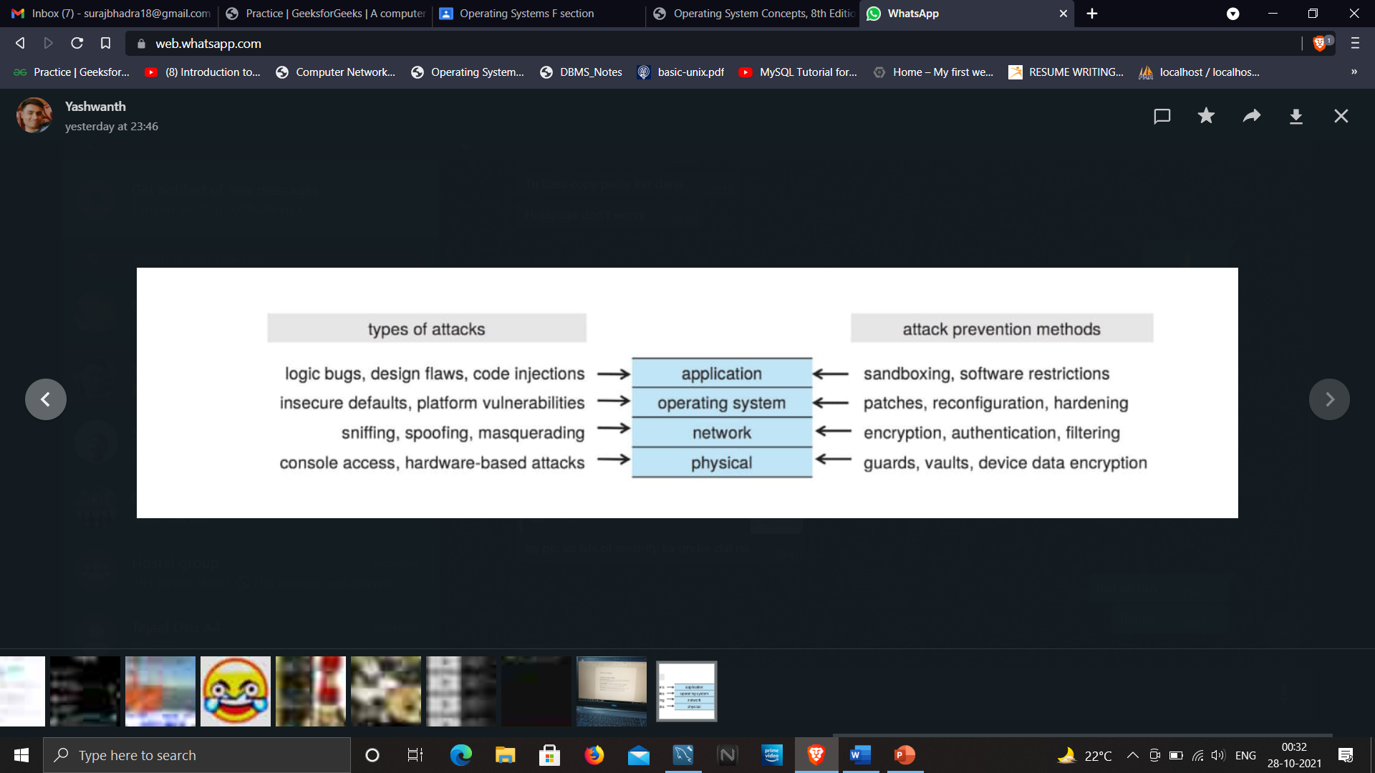

Slide 20
CONCLUSION
Protection is an internal problem. Security, in contrast, must consider both the computer system and the environment people, buildings, businesses, valuable objects, and threats within which the system is used.
The data stored in the computer system must be protected from unauthorized access, malicious destruction or alteration, and accidental introduction of inconsistency.
Methods of preventing or detecting security incidents include an up-to-date security policy, intrusion-detection systems, antivirus software, auditing and logging of system events, system-call monitoring, code signing, sandboxing, and firewalls.

Slide 21
Real systems are much more limited than the general model. More modern systems are closer to the general model, or at least provide a variety of protection features to protect the system and its users.
Consider implementing the following security for best practices :
User Accounts
Account Policies
File system
Network Services
System Patches
Operating System Minimization
Logging and Monitoring
System Integrity

Slide 22


